Slide 1

Zowe 4Q 2022
PI Planning
TSC Wrap Up
Presenter: Jakub Balhar
Notes:
I want to to fit it in 5 minutes.
Alignment?
Containerization
Something to change?
May be missed by the other squads?
V2
Security

Slide 2

Major Topics (TSC perspective)
CII Badge
Implementation
1-year Roadmap
Security
DevSecOps focus
Track Open SSF Eforts
CVE Numbering Authority
New Technologies
Chat: Technical Preview Delivery
App Store: Technical Preview Delivery
Intellij Explorer: GA Delivery
Community Growth
Mentorships
Extenders
Training & Certification
App Store - Design, Further Work
We ARE Chatting!

Slide 3
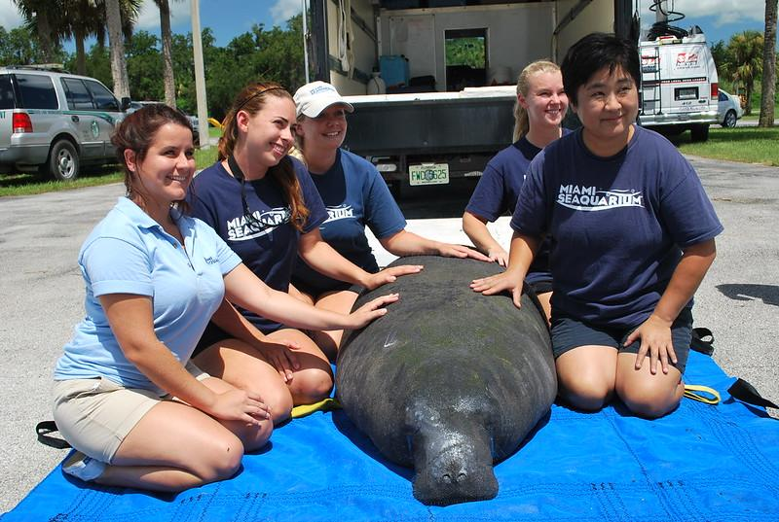
Next Releases
Zowe V2
2.5 - 2022/12/12
2.6 - 2023/01/23
Zowe V1
1.28.2 - 2022/11/28
Release to the river

Slide 4

Closing Remarks
Security
Remains a key topic
Ready to be more visible
In Search Of Feedback
Leverage Technical Preview
Bring your customers to the wider community
More tools to gather the feedback
How do we share news?
Installation
Improving the experience
We do care

Slide 5

Thanks everyone!

